Slide 1

Analyze Twitch Gaming Data
Analyze Data with SQL
Mohammad Reza Sadeghi

Slide 2
Table of Contents
What are the unique game and channels in stream?
What are the most popular games?
Geographical Distribution of LoL Stream Viewers?
What sources users use to watch players stream?
Categorization of Games into Genres?
View Count Analysis for Each Hour?
Conclusions

Slide 3
1. Unique game and channels

Slide 4
1. What are the unique game and channels in stream table?
On the right, there are two tables showcasing valuable insights. The first table highlights the distinct games currently featured on Twitch streams, offering a comprehensive overview of the diverse gaming content available. The second table provides a glimpse into the unique channels actively streaming, presenting a snapshot of the varied and dynamic creator landscape on the platform..
Games
League of Legends
DayZ
Dota 2
Heroes of the Storm
Counter-Strike: Global Offensive
Hearthstone: Heroes of Warcraft
The Binding of Isaac: Rebirth
Agar.io
Gaming Talk Shows
Rocket League
World of Tanks
Channels
channel
jerry
elaine
frank
estelle
george
newman
susan
kramer
morty
helen
SELECT DISTINCT game FROM stream
SELECT DISTINCT channel FROM chat

Slide 5
2. Most popular games

Slide 6
2. What are the most popular games on stream table?
Games | Players
League of Legends | 1070
Dota 2 | 472
Counter-Strike: Global Offensive | 302
DayZ | 239
Heroes of the Storm | 210
The Binding of Isaac: Rebirth | 171
Gaming Talk Shows | 170
Hearthstone: Heroes of Warcraft | 90
World of Tanks | 86
Agar.io | 71
Rocket League | 49
SpeedRunners | 20
ARK: Survival Evolved | 19
Duck Game | 5
Fallout 3 | 3
Batman: Arkham Knight | 3
Breaking Point | 2
Block N Load | 2
Devil May Cry 4: Special Edition | 1
In the left table, you can observe the player counts for each game on Twitch streams. Notably, League of Legends, commonly known as LOL, stands out as the most popular game, boasting twice as many players on Twitch as the second-ranked game
SELECT game, COUNT(player) as 'Players'
FROM stream
GROUP BY 1
ORDER BY 2 DESC

Slide 7
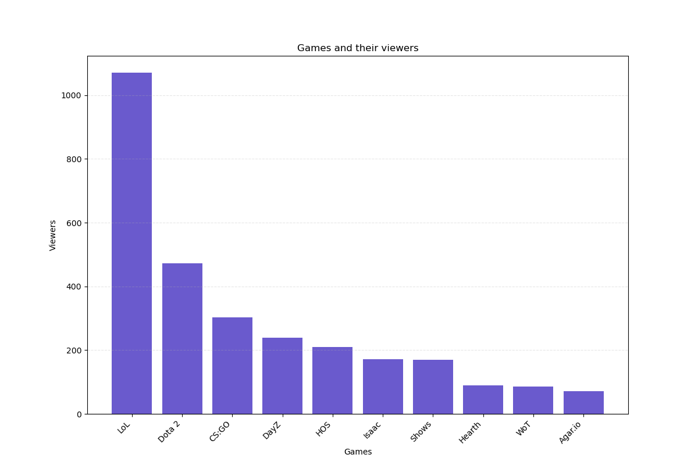
The chart exhibits a right-skewed distribution, indicating that the first four games receive significantly higher views compared to the remaining ones.

Slide 8
3. Locatoin of LoL stream viewers

Slide 9
3. Where are most LoL stream viewers located?
Country | LOL Players
US | 447
DE | 66
CA | 64
NULL | 49
GB | 45
TR | 28
BR | 25
DK | 20
PL | 19
NL | 17
BE | 17
SE | 16
RO | 16
MX | 16
PT | 15
FR | 15
AU | 15
NO | 13
IT | 13
GR | 10
ES | 10
In the right-hand table, you can explore the geographical distribution of League of Legends (LOL) players. Countries with fewer than 10 players in the LOL game have been excluded for clarity, but you can view the complete results by executing the prompt below.
Notably, the majority of LOL players are from the United States, surpassing the second-ranked country by a staggering sevenfold.
SELECT country, COUNT(*) AS 'LOL Players'
FROM stream
WHERE (game = 'League of Legends')
GROUP BY 1
ORDER BY 2 DESC

Slide 10
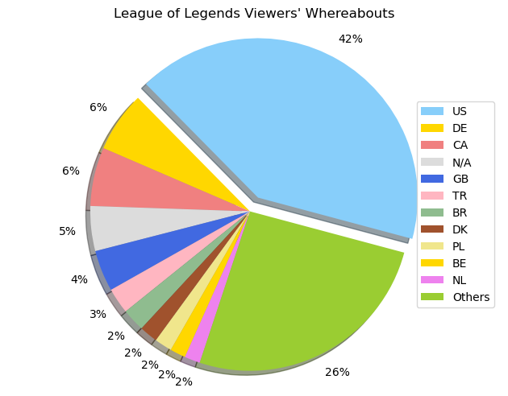
You can see better view of LOL whereabouts in chart

Slide 11
4. Streaming Platforms Preferences

Slide 12
4. What sources users watch players stream?
The majority of users, approximately 45%, opt for the Twitch website itself as their primary streaming platform, indicating its widespread popularity.
Following closely are smartphone users, with iPhones and Android phones securing the second and third positions, collectively accounting for about 38% of the user base.
The dominance of the site as the preferred platform underscores its significance, overshadowing mobile devices in terms of user preference.
Player | Users | Percentage
site | 1365 | 45.5
iphone_t | 622 | 20.73
android | 547 | 18.23
ipad_t | 290 | 9.66
embed | 125 | 4.16
xbox_one | 22 | 0.73
home | 16 | 0.53
amazon | 6 | 0.2
frontpage | 4 | 0.13
xbox360 | 1 | 0.03
roku | 1 | 0.03
chromecast | 1 | 0.03
SELECT player , COUNT(*)
FROM stream
GROUP BY 1
ORDER BY 2 DESC

Slide 13
5. Games and their genres

Slide 14
5. Categorization of Games into Genres?
Adjacent to this information, the genres of the games are displayed, featuring Multiplayer Online Battle Arena (MOBA), First Person Shooter (FPS), and Survival
Campaign | Genre | Users
League of Legends | MOBA | 1070
Dota 2 | MOBA | 472
Counter-Strike: Global Offensive | FPS | 302
DayZ | survival | 239
Heroes of the Storm | MOBA | 210
The Binding of Isaac: Rebirth | Other | 171
Gaming Talk Shows | Other | 170
Hearthstone: Heroes of Warcraft | Other | 90
World of Tanks | Other | 86
Agar.io | Other | 71
Rocket League | Other | 49
SpeedRunners | Other | 20
ARK: Survival Evolved | survival | 19
NULL | Other | 15
Other games | Other | 16
WITH genre AS (
SELECT game,
CASE
WHEN (game = 'League of Legends') OR
(game = 'Dota 2') OR
(game = 'Heroes of the Storm')
THEN 'MOBA'
WHEN game = 'Counter-Strike: Global Offensive' THEN 'FPS'
WHEN (game = 'DayZ') OR
(game = 'ARK: Survival Evolved')
THEN 'survival'
ELSE 'Other'
END AS 'genre',
COUNT(*)
FROM stream
GROUP BY 1
ORDER BY 3 DESC) SELECT * FROM genre

Slide 15
6. View Count Analysis for Each Hour

Slide 16
6. How many users view streams in each hours of day in U.S?
Due to time differences, I focused on the United States for player and viewer data.
The tables reveal that users predominantly watch streams between 18:00 and 22:00, with lower viewership from 5:00 to 10:00. Apart from these times, viewership remains relatively consistent throughout the day, indicating a steady presence of users tuning in to streams.
Time | View count
21 | 120
20 | 102
19 | 81
18 | 76
22 | 71
16 | 69
23 | 63
12 | 62
13 | 58
17 | 55
15 | 51
11 | 48
Time | View count
14 | 40
02 | 34
00 | 30
03 | 29
04 | 19
01 | 17
05 | 14
09 | 9
10 | 5
08 | 4
06 | 3
07 | 2
SELECT
strftime('%H', time) AS 'Time',
COUNT(*) AS 'View count '
FROM stream
WHERE country = 'US'
GROUP BY 1
ORDER BY 2 DESC

Slide 17
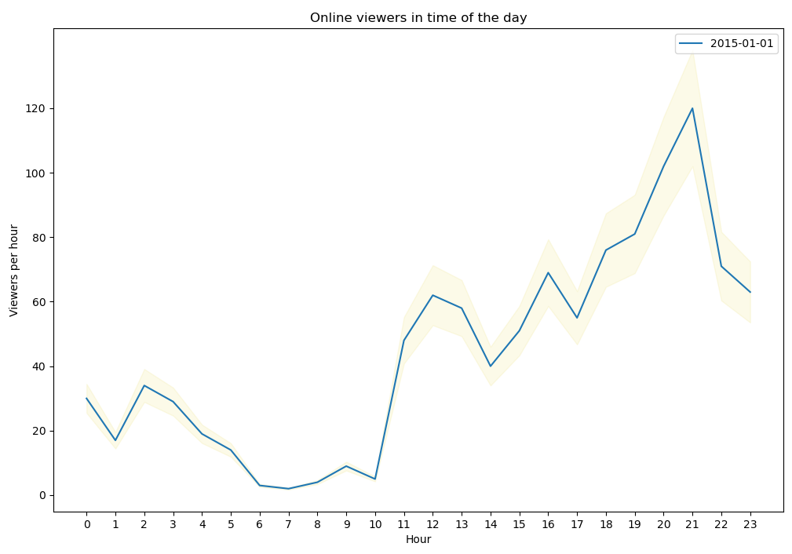
There's a level of uncertainty in these numbers as some individuals leave their browsers open. To address this, we'll factor in a 15% error margin in the viewers_hour data.
The viewership count increases from 10 AM, peaking at 9 PM before gradually declining

Slide 18
7. Conclutions

Slide 19
7. Conclusions
League of Legends Dominance:
League of Legends (LOL) emerges as the preferred game for players to stream on Twitch.
US Leads in Player Count:
The United States boasts the highest player count among all countries, with 1062 players out of 3000, securing a substantial lead. Taiwan holds the second position with 178 users.
Preferred Streaming Platforms:
The Twitch website is the most favored platform for users to watch streams, followed by mobile phones.
Popularity of MOBA Genre:
Multiplayer Online Battle Arena (MOBA) captures over 50% of the overall traffic, indicating its significant popularity among both players and viewers.
Peak Viewing Hours:
The peak viewing hours are concentrated between 18:00 and 22:00, with a secondary peak observed between 5:00 and 10:00. Despite lower viewership during these periods, the overall variation throughout the day is minimal, emphasizing a consistent user presence on the platform.

